Slide 1
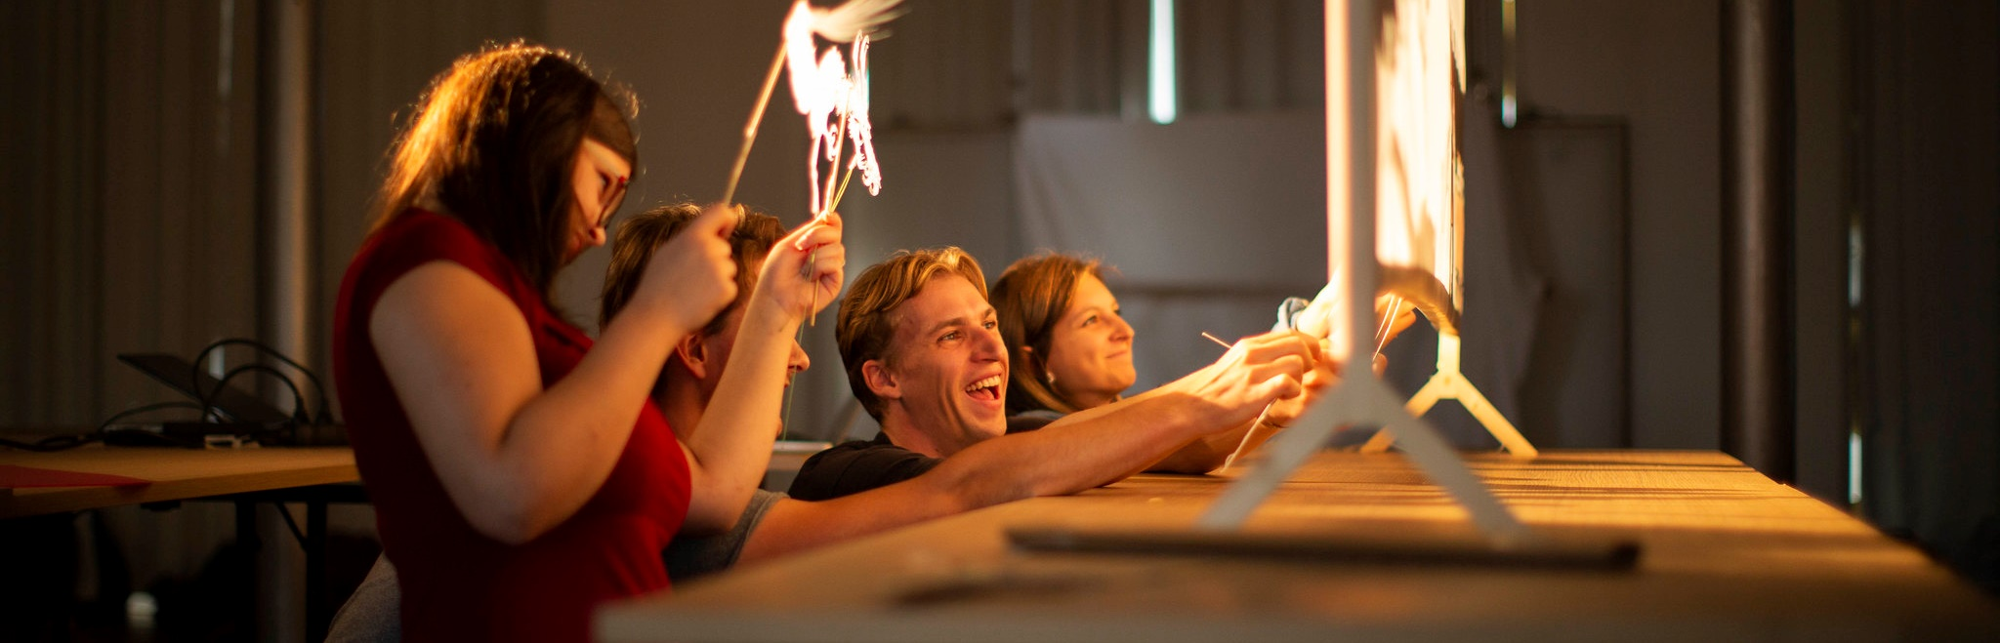
LUCA School of Arts
LUCA School of Arts is the only university college in Flanders exclusively dedicated to art and design, making it unique in the region. The art school combines the strengths and expertise of five renowned Flemish higher education institutions for art and design, spread across Brussels, Genk, Ghent and Leuven.

Slide 2
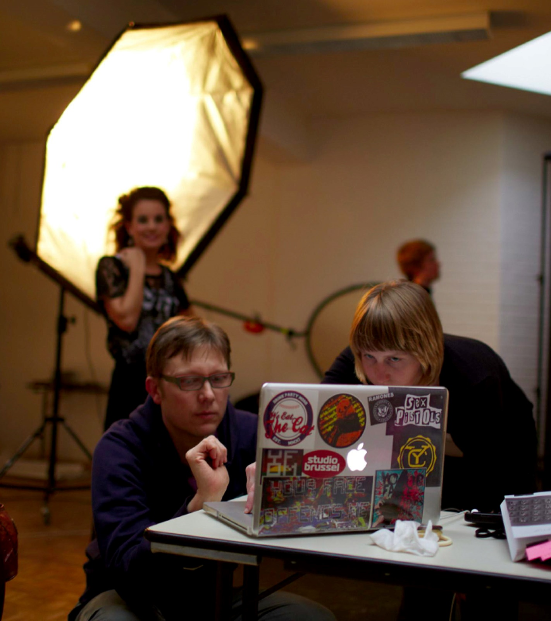
Application flow More info: Applying for a Master
01
Apply through Admissions
Upload your ID/passport, original diploma and transcript + official translations (if not in EN, FR, NL, DE) and language certificate (level B2)
IMPORTANT: Participate in the first master assessment if you are a non-EU candidate or if you want to be eligible for the Master Mind scholarship!
02
Register for a Master Assessment (MTA)
3 different deadlines for the online part:
1st MTA: 27th of Feb for Music & Drama (Leuven) & 12th of March for all other programmes (Brussels, Ghent, Genk)
2nd MTA : 24th of June (31st March for Drama) 3rd MTA : 26th of August
Exception: For the English MA in Fine Arts applications are handled through Dreamapply (Admissions and MTA within the same application form)

Slide 3
Application flow
03
Complete the online assessment
05
Final Registration
If you are accepted, you will receive an admission letter. With this you can register as a student.
Note: The final registration can take a while (around a month) to be processed.
Note: You could also be accepted for a preparatory or bridging programme instead of the master programme.
Note: If one of the admissions requirements still needs to be fulfilled, you will temporary receive a conditional admission letter. This cannot be used to register.
Upload a CV, motivation, portfolio and for Brussels a project proposal.
More info: Master Assessment
04
Interview
If you pass the online part of the assessment, you may be invited for an interview.

Slide 4
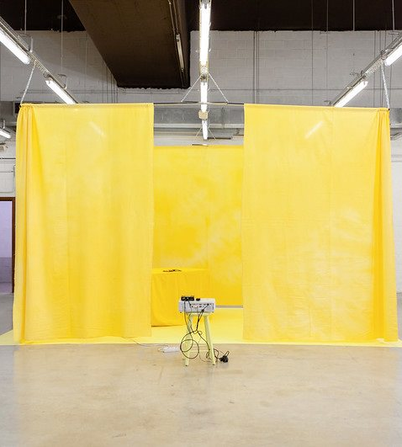
FINANCIAL
Expenses & support
FAQ Financial
Tuition fees and Master mind scholarship

Slide 5

Financial
No application fee
Tuition fee: Total fee depends on the type of programme you are following and the number of credits you are enrolled for.
F.e. As a non-EEA-student* or EEA-student applying for a full time (60ECTS/year) arts and design related degree, in 2025-2026* you'll need to pay:
  - the fixed amount of € 299
  - added with 60 credits (=the amount of credits you enrol in) x €14,30
  = €1.157 / year.
  * For the Music and Erasmus Mundus programmes non-EEA students may need to pay a higher amount
There is also an additional material cost which differs between studio's. The amount of this cost fluctuates between €200 and €400 / year.
Living costs: Useful site: https://www.numbeo.com/cost-of-living/
Insurance: https://www.luca-arts.be/en/insurance-international-students-luca
EXPENSES

Slide 6
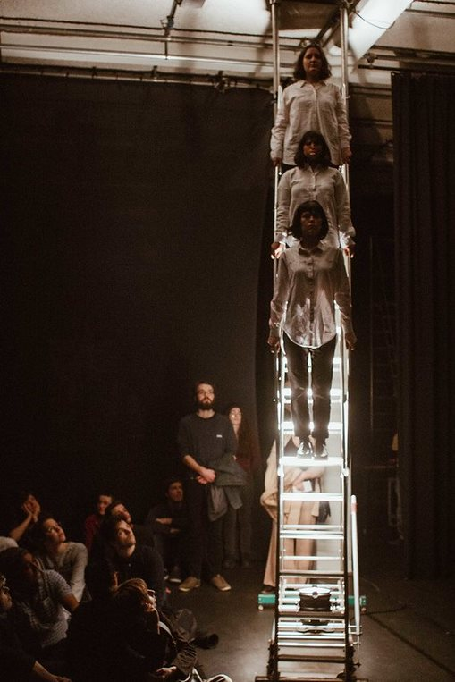
Financial
SUPPORT
Master Mind Scholarship for outstanding students taking a Master’s course in Flanders for the first time. Eligibility criteria - Study in Flanders (min. 3.5/4 GPA)
Apply for an eligible Master AND register for the earliest Master Assessment!
Option to request a payment in installments: https://proform.luca-arts.be/student (Afwijkende betalingsmogelijkheid) (This should be requested before the end of October)
Emergency support by Stuvo: https://www.luca-arts.be/en/financial-support-student-support-services

Slide 7
VISA AND RESIDENCE PERMIT
VISA APPLICATION
This can be a lengthy process (up to 3 months) so it is recommended to start your visa application process as soon as possible once you’ve received your admission letter: FAQ VISA
PROOF OF SOLVENCY
As part of your visa application you will need to provide proof of sufficient financial means. There are 3 ways to do this: official grant or scholarship, Annex ’32 (financial guarantor), Blocked account
BLOCKED ACCOUNT
You can use our Blocked Account for 1. the purpose of a study related stay at LUCA (first residence permit or permit renewal) or 2. After graduation: for the purpose of extending your residence permit in the framework of a 'search year’
REGISTRATION CITY OFFICE
Once you’ve arrived in Belgium, you will need to present yourself at your local city office or town hall to register your long-stay (i.e. of more than 90 days) and apply for a residence card. Registration procedure for foreign students at the Belgian city office

Slide 8
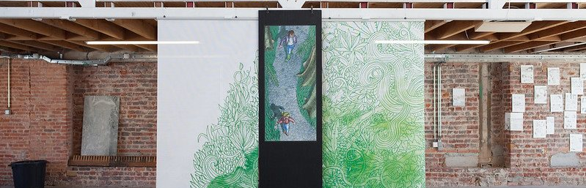
Student Support Services
Student support services (STUVO) with contact persons per campus:
Stuvo LUCA Brussel
Stuvo LUCA Gent
Stuvo Campus Lemmens
Stuvo Campus C-mine

Slide 9
STUDENT SUPPORT SERVICES
Health & Wellbeing
Student counselling
Money matters
Freetime
Health Care
Psychological assistance
Special needs students
Psychological assistance
Confidential advisor
Ombuds office
Learning path counselling
Student jobs
Financial support by student support services
Sports & culture
Mobility
Cafetarias

Slide 10
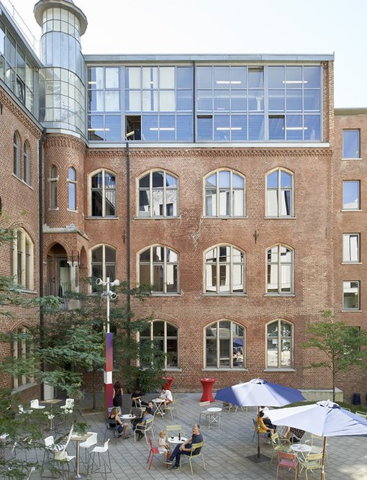
ACCOMMODATION
Offers and tips per city can be found on our Housing page: https://www.luca-arts.be/en/housing
SHORTAGE
FRAUDE
Finding accommodation in bigger cities can be challenging so start looking as soon as possible.
Beware of fraudulent advertisements. Please look at the tips on our Housing page.
KU LOKET
Please update the Residence Address in your online Student File (KU Loket) to the address on your rental agreement.

Slide 11
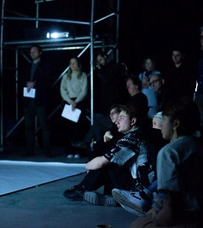
COURSE CATALOGUE
ENGLISH PROGRAMMES:
https://www.luca-arts.be/nl/english-programmes
COURSE GUIDE:
Education - LUCA (luca-arts.be)
Note: Min 54 credits for non-EU students

Slide 12
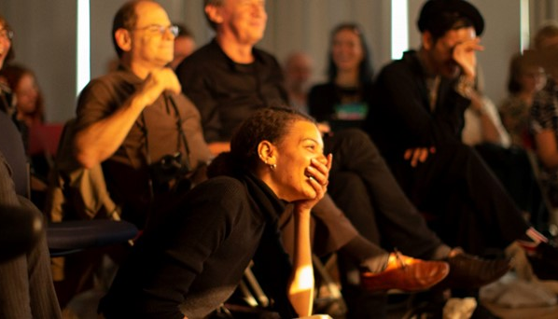
Maybe until soon!
More questions that cannot be answered today?
International Office: international@luca-arts.be
(General questions, Master Mind etc.)
Admissions Office: admissions@luca-arts.be
(Application & required documents, visa, blocked account etc.)
Student Support Services: Contact details per campus

