Slide 1
Planning and organizing
For students of LUCA School of Arts
Notes:
Welcome to the online workshop planning and organizing.

Slide 2
Info in advance
This workshop was made by the study needs assessors of LUCA School of Arts.
This symbol: shows that it is time for an exercise.
If you want more information about this or other workshops, you can contact the study needs assessors . You can find their names and contact details at the end of the PowerPoint.

Slide 3
What can you expect from this online workshop?
Current approach
Information sheet
Productive hours
Types of schedules
Prepare your schedule
Credits
Questions?
Finally
Notes:
First, you look at your current approach based on a few statements. Then we look at how you can create an information sheet per course. You then check what your productive hours are to work for school. You will then find some examples of schedules. Finally, you make a schedule yourself.

Slide 4
Current approach
Answer the following statement with yes – sometimes - no
I postpone assignments until the deadline approaches.
Before I start studying a new chapter, I first think about the best way to study it.
Because of other activities, I don’t spend much time on my studies.
I notice that I have difficulty learning a large amount of subject matter.
I have trouble organizing my time.
I need the pressure of the examns to perform.
I could use my time more efficient.
At the beginning of the week I don’t know how much time I will spend on my studies that week.
I am a morning person so I make sure to get up early and start studying.
Notes:
To see how you approach studying and planning now, here are a few statements that you can answer with yes, sometimes or no.
You can use the statements as a self-evaluation.
Do you feel that you are doing well? Good. Check your opinion by going through this workshop.
If you feel that you are not doing well yet, you can find tips in this workshop to adjust your approach.

Slide 5
2. Information sheet
Collect all the information you have about the course and make an information sheet:
Core content of the course
Studymaterial
Assesment method
Notes:
To get an overview of all your assignments, courses and the way in which they will be offered in the coming period, you collect all the necessary information for each course. You can find this information via Toledo, via your student email, other learning platforms that teachers use or in the ECTS file.
The best way to organize this information is to make an information sheet with all the important information for each subject.
Think about the following questions:
• What is this course about? What are the core themes?
• What is the study material? Where can I find that study material?
• How will the course be evaluated? Which assignments or tasks do I have to complete? Which texts, videos or parts of a course do I need to know? Is there an exam, a jury or a paper?
Collecting all the information may take some time, but it will save time in the long term because you do not have to go back to look up all that information.

Slide 6
3. Productive hours
Productive hours
You are concentrated and can do a lot of work in a (relatively) short time.
You can process and memorize learning material.
Less productive hours
You are focused but feel that it is a little less. You can do something, but not things that require a lot of focus.
You can do support work such as preparing, planning, looking up things,…
Notes:
It is important to know when your productive hours are so that you can plan the right things at those times. You have productive, less productive, unproductive and lost hours.

Slide 7
Unproductive hours
Time you use to relax, eat, sleep and move around.
You planned this so these are not lost hours. These hours are also very important.
Lost hours
Time in wihch you wanted to study or relax but didn’t.

Slide 8
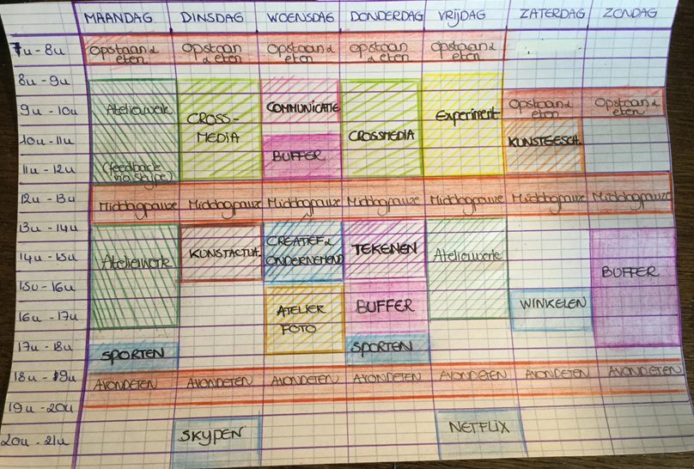
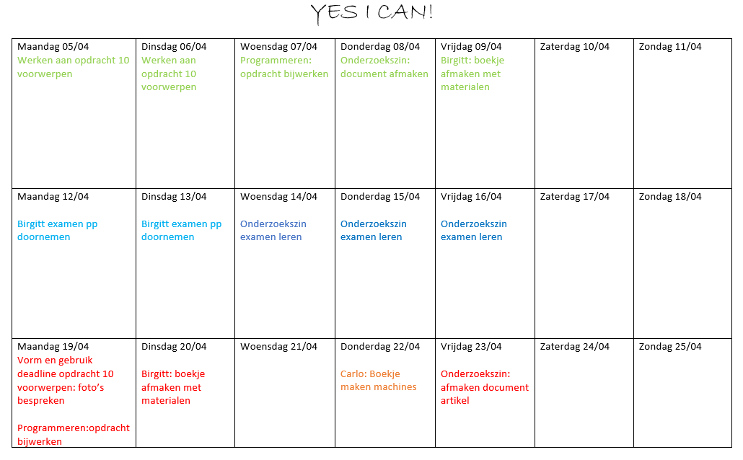
4. Types of schedules
Tight schedule vs. Loose planning
Notes:
We now look at the different types of schedules. Do you need structure? Do you like to plan ahead and do you like to know when you should be doing what? Are you someone who needs a well-planned schedule to be able to adhere to it (because otherwise you will let other things take precedence over your planned things)? Then a tight schedule suits you best. With a tight schedule, you plan your entire day. You put your lessons, your assignments and your deadlines in your planning, but also your relaxation, eating moments and sleep, in other words your free time.
When drawing up a tight schedule, it is important that you take unexpected events into account. Working with buffers is the solution for this. Buffers are extra spare time that you provide incase you didn’t got your planned tasks done of for unforeseen circumstances.
Don't like having your whole day planned out in advance? Do you prefer a little more freedom? Or do you quickly get stressed when you cannot follow your schedule correctly? Then a free schedule is want you need. A free schedule contains all your deadlines and you also plan in advance which day you will work on which deadline or which day you will study for which subject, but not which hours. With this schedue you are more free to choose which course you study in the morning and which one in the afternoon and when you take breaks.

Slide 9
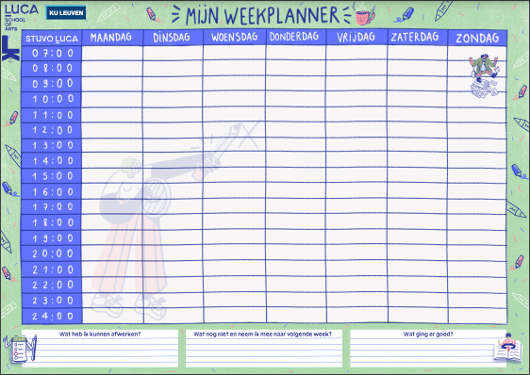
Short or long term schedules
Day, week, month of semester schedule
Notes:
In addition to a tight or a free schedule, you can also choose between a short-term schedule, namely a day or a week schedule, or a long-term schedule such as a monthly or semester schedule.
You can download the sample plans that you see here via the following link: https://www.luca-arts.be/nl/studiebegeleiding
In these example schedules, the weekly planner is a tight schedule and the 6-week planner is a free schedule.

Slide 10
To do schedule
Notes:
The TO DO schedule is a different kind of free schedule. You can also combine this schedule with another free or tight schedule.
Take two large papers and write, on top of the papers, “TO DO” and “DONE”.
Then take a stack of post-its in 2 colors. Take your stack of sticky notes of one color and write all your deadlines on it. Clearly state the date of the deadline, what the assignment is and for which course. Write on the different color post-its what you have to do for the assignments. Chop the assignments into pieces, for example find a location, take photos, edit photos. You can also write down all the chapters of courses you want to learn on the post-its. This is especially useful during the block and exam period. Hang the 2 papers above your desk and stick all your post-its on the paper TO DO. When you're done with a post-it, move it to the paper DONE.
Did you know that it is motivating when you can move a post-it to "DONE"? So leave the post-its there for a while, so you can see that you are making progress.

Slide 11
5. Prepare your schedule
Make an information sheet.
Choose which type of schedule works best for you.
Start filling in your schedule.
Start filling in your deadlines.
Determine how much time you need.
Use collors
Evaluate and adjust if necessary
Notes:
Start by filling in your deadlines on your schedule and use the same color for all deadlines. Write down the deadlines with the correct date and state for which course this deadline is and briefly write what the assignment implies or give the assignment a clear name so that you know which assignment it concerns. If you make a schedule for the exams, the deadline is your exam during the exam period.
Think about how much time you will need for a particular course or assignment. You can take into account the number of credits for a course. We will discuss this in the next slide. But you can also take into account how good you are in a particular subject and how interesting you find that subject or assignment.
If you have a tight schedule, write with different colors in your schedule: 1) when you have which lesson, 2) your relaxation, 3) buffer moments, 4) which moments you work for which assignment or for which course you will learn. With a tight schedule you can go concrete and plan what you will do at that moment. If you draw up a free schedule, you can only note the course or the assignment on that day. In other words, you have two colors in your free planning, namely one for your deadlines and one for the course or assignment.

Slide 12
6. Credits
Guideline: 1 credit represents 25 to 30 hours of study time. This includes:
Take classes;
Make assignments;
Study;
Taking exams.
Full program = 60 credits
60 credits x 25 to 30 studytime = 1500 à 1800 hours studytime / academic year..
An academic year : 40 weeks.
1800 hours study time : 40 weeks = 45 hours/week study time.
Example: a course of 3 credits requires 75 to 90 hours study time.
Notes:
When drawing up your information sheet, also check how many credits a course has. You can find that in your ISP or in the ECTS file. Some courses represent 3 credits, others 6 or more. The general guideline is that 1 credit represents 25 to 30 study hours. This includes: taking classes, completing assignments, studying and taking exams.
If you follow a full-time day program, you have 60 credits. 60 credits times 25 to 30 hours of study time equates 1500 to 1800 hours of study time per academic year. An academic year lasts 40 weeks. To find out how many hours of study time you will need per week, divide the total number of hours of study time by the number of weeks. This equates to approximately 45 hours of study time per week that you will need, which may be slightly more for some degree programs with a lot of practice. As an example we take a course of 3 credits. The total study time for this will be 75 to 90 hours.

Slide 13
Questions?

Slide 14
If you have questions, remarks or if you need extra guidance, you can contact the study needs assessors of your campus
→ Anne-Lies Bas for Genk and Leuven - annelies.bas@luca-arts.be
→ Els Verbruggen for Brussel and Vorst - els.verbruggen@luca-arts.be
→ Ruth De Hert for Gent - ruth.dehert@luca-arts.be
Website: https://www.luca-arts.be/nl/special-needs-students Instagram: https://www.instagram.com/lucazorgcoaches/

Slide 15
Finally

Slide 16
This online workshop was the first step in learning how to take notes 💪
Try out the tips as much as possible
Every beginning is difficult but doing it will make it more easy
We wish you goodluck!
Notes:
This workshop was your first step in learning to plan. It may not all work out the first time, but that’s okay. Every beginning is difficult and it will always go smoother. Try out the tips as much as possible in the coming weeks.
Goodluck!

